Slide 1

Chicago Crime Analysis with Apache Spark
Yinan Li

Slide 2


Outline
Project Overview
Objective and data source
Approaches
Data Preprocessing
Data cleaning
Explorative data analysis
Unsupervised learning task
K-means clustering on spatial data
Time series analysis
Predict crime case number in the next years using historical data

Slide 3



Objectives & data analytical approaches
Project Overview

Slide 4


Introduction
Sitting on the shores of Lake Michigan, Chicago is an international hub for culture, arts, finance, technology, and education. Historically, however, it has also been home to gangs and has seen many crimes.
To improve safety in the city and help the police department design better patrol systems, this project aims to extract patterns from historical data and make predictions using modern machine learning techniques.

Slide 5
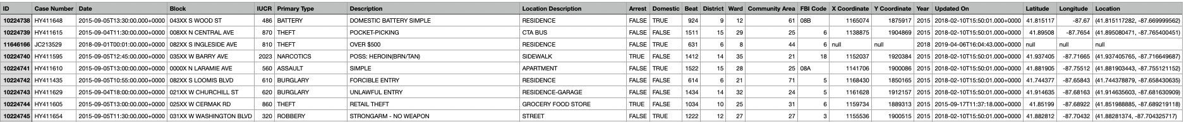

Chicago crime report (2001 – present)
“Big” data: 7 million+ records
Traditional data analytical tools cannot handle it

Slide 6

Explorative Data Analysis
Data Preprocessing
['OFFENSE INVOLVING CHILDREN’, 'CRIMINAL SEXUAL ASSAULT’, 'ARSON’, 'BATTERY’, 'HOMICIDE’, 'ROBBERY’, 'KIDNAPPING’, 'DOMESTIC VIOLENCE']

Slide 7
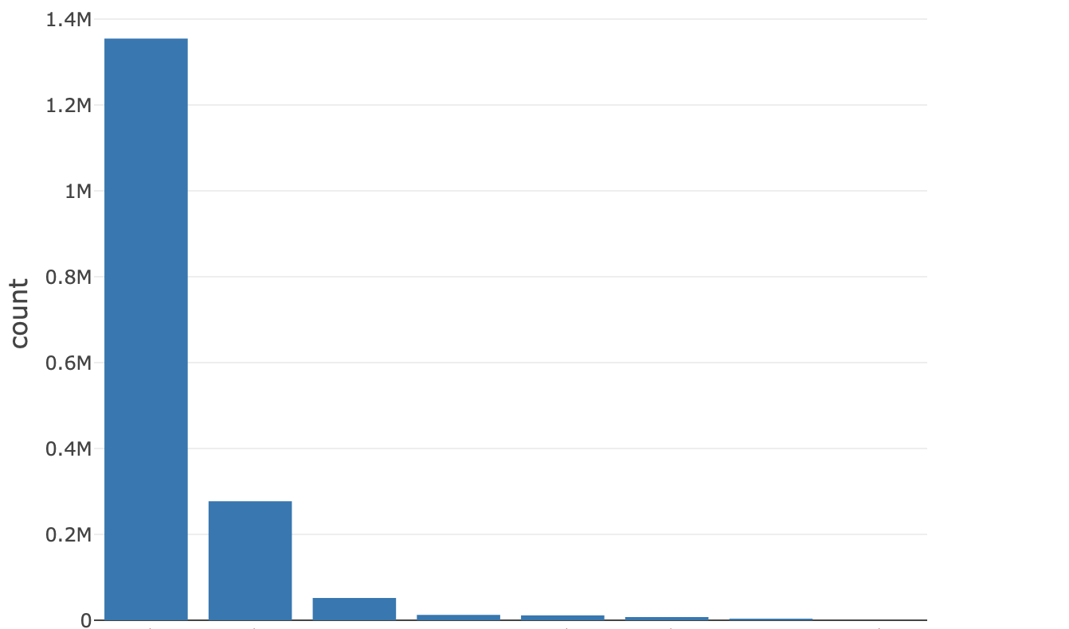
Case number by type of crime
BATTERY
ROBBERY
ARSON
HOMICIDE
KIDNAPPING
OFFENCE WITH CHILDREN
DOMESTIC VIOLENCE
CRIMINAL SEXUAL ASSAULT

Slide 8
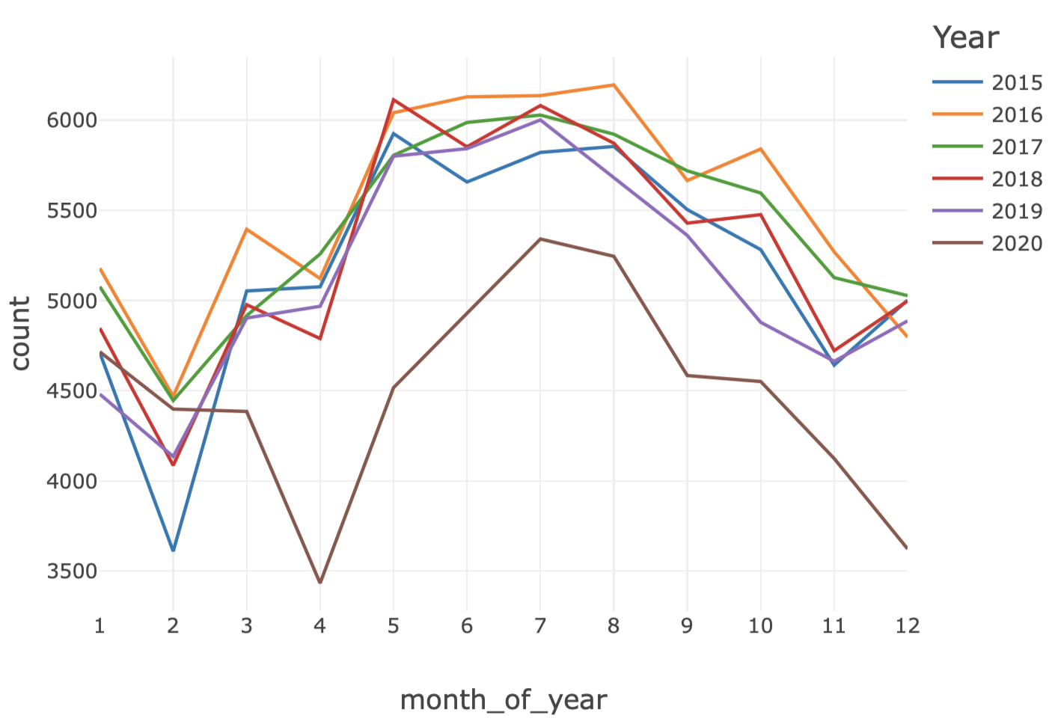
Case number by time
Insights:
Crime in the city shows strong seasonality
There is a local maximum for case number during the holiday season
Social impact from COVID and associated policies (e.g. work-from-home) plays an important role
Suggestions:
Increase police patrols in Summer and during holidays

Slide 9
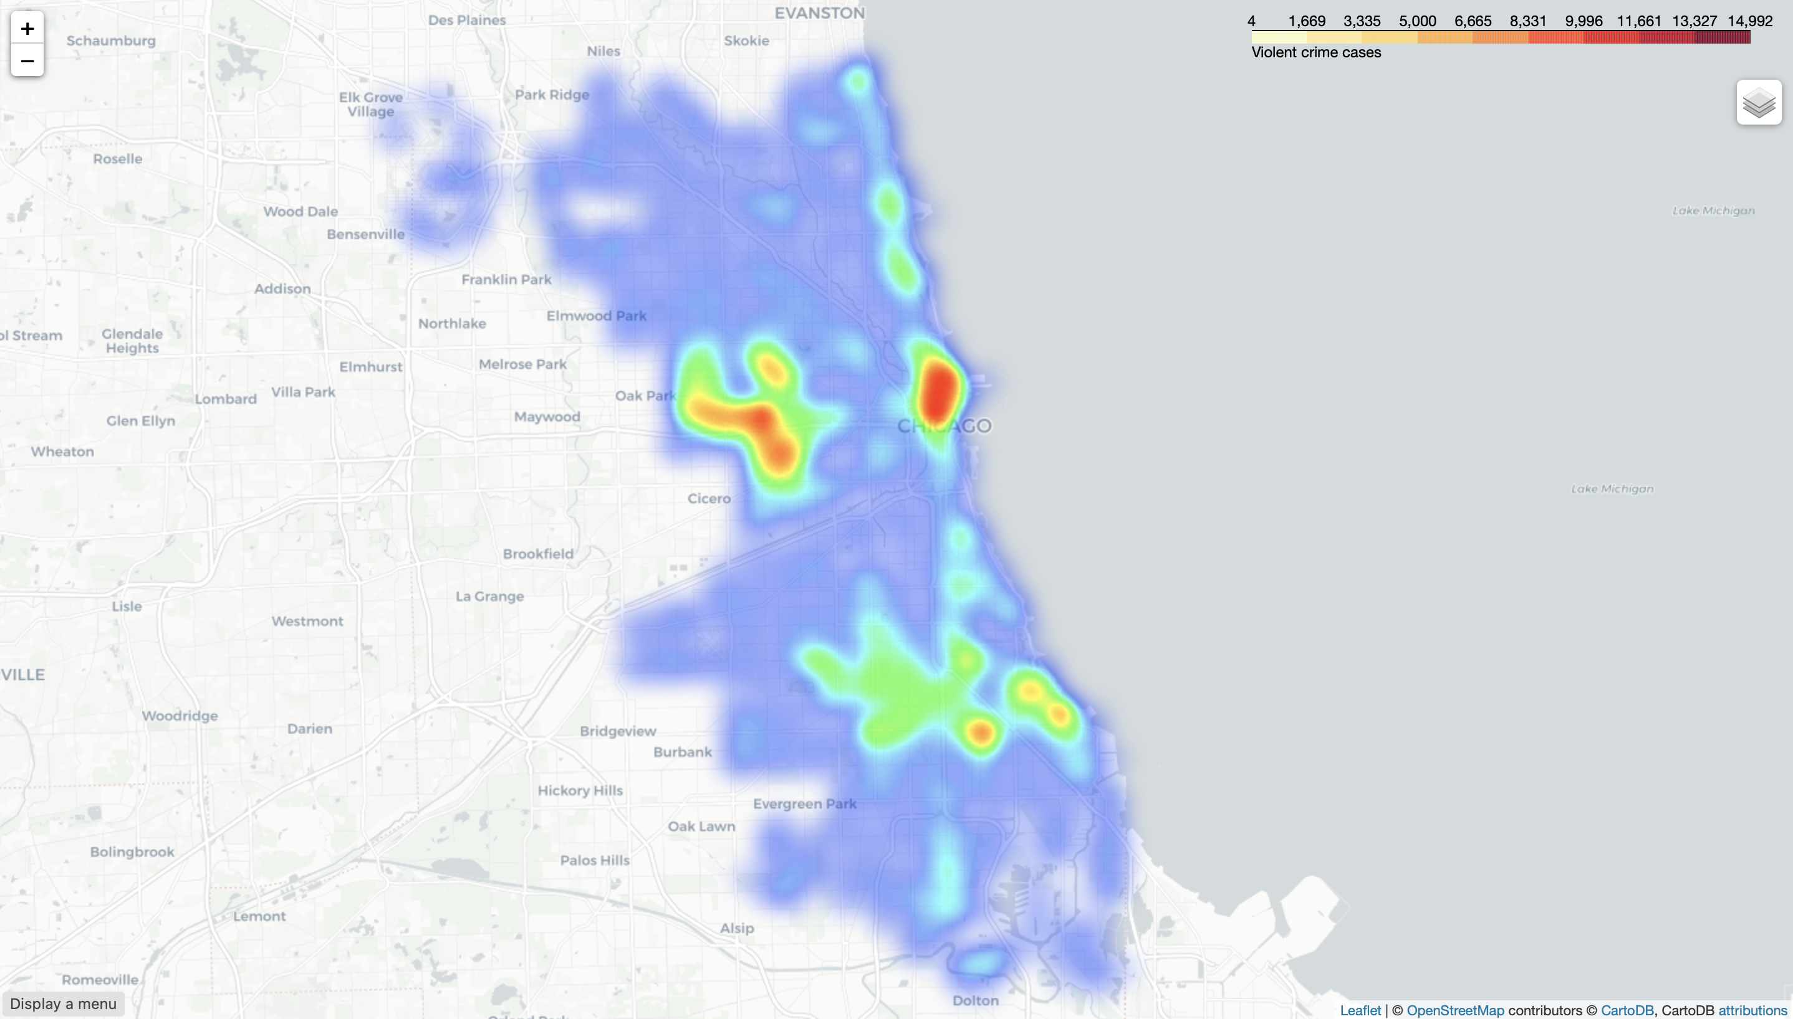
Visualizing crime hotspots with heatmap
Suggestion:
Localized patrols deployed at hotspots and in districts with high numbers of cases
(data from 2020)

Slide 10




Unsupervised ML task
Clustering spatial information of crime cases using K-means algorithm
Find ideal locations to build police stations

Slide 11
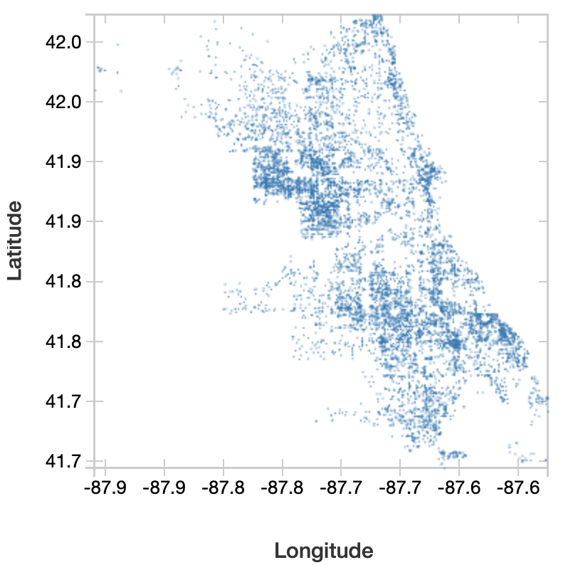
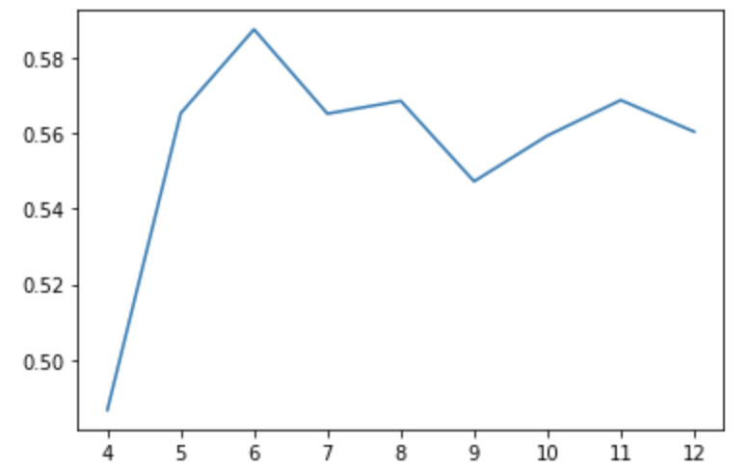
Spatial clustering with K-means
Looking for a reasonable value for “k”
Silhouette score
Number of clusters

Slide 12
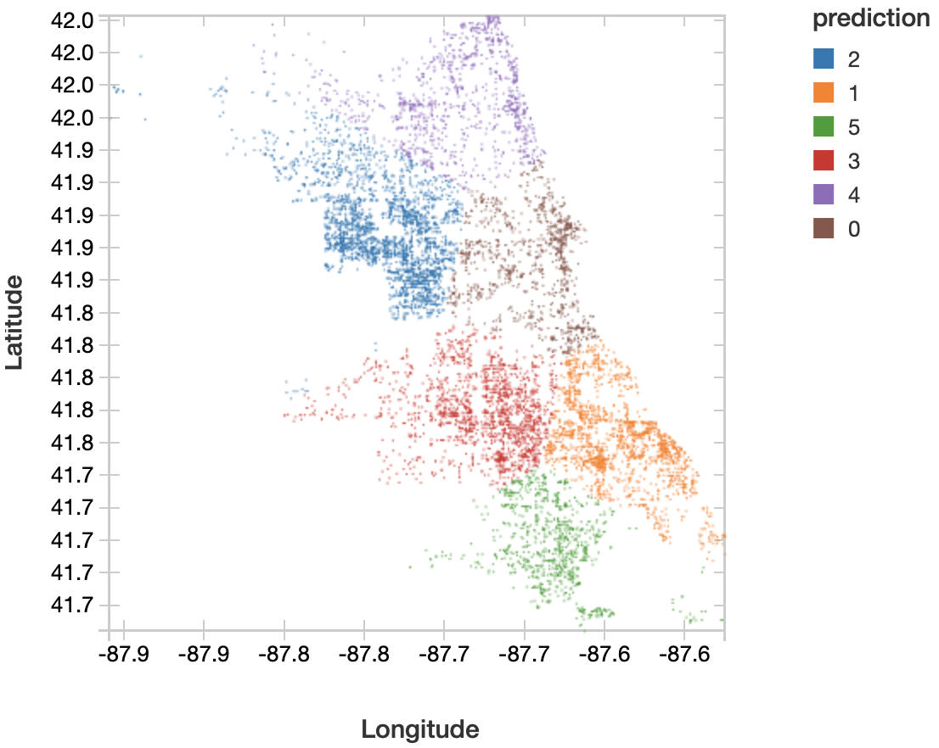
Spatial clustering with K-means

Slide 13
Spatial clustering with K-means
Insight:
Each cluster represents a highly localized and compact region with crime cases
Suggestion:
Building police stations or helicopter stations at the center of each cluster may be a cost-efficient way to distribute police force

Slide 14

Time series analysis
Forecasting future case number using historical crime and weather data

Slide 15
Chicago crime case number forecasting
Objective
Use historical crime data to predict case number in the future (the next 12 months
Available data:
Historical data - number of cases happened in the (immediate) past
Recall seasonality observed earlier
Temperature data
Other data that might be useful:
House prices
COVID case number (if we were to forecast in 2020)
In practice:
Use historical crime and temperature data from 2001/1 – 2018/12 to train model
Forecast and evaluate model performance using data from 2019/1 – 2019/12

Slide 16
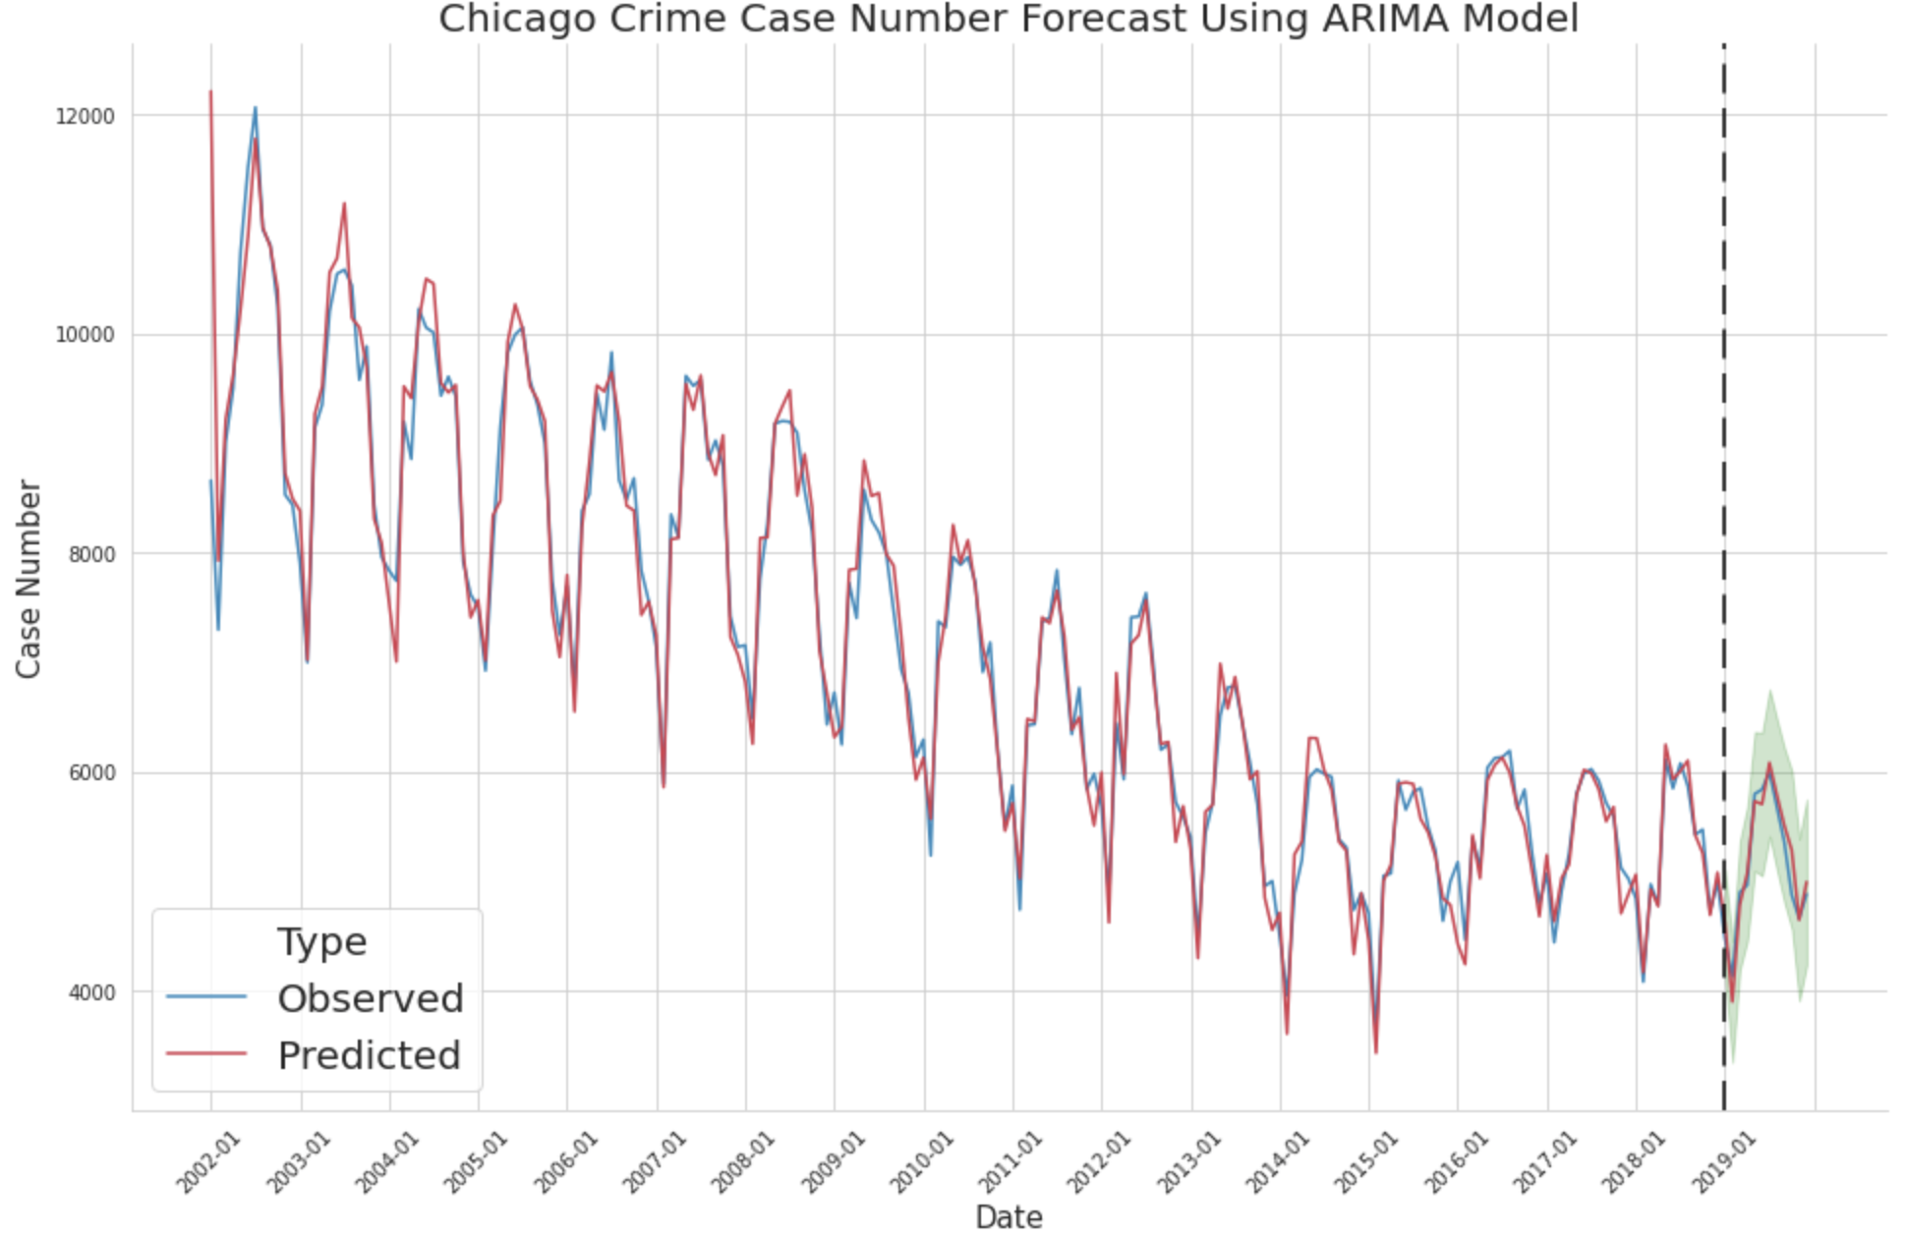
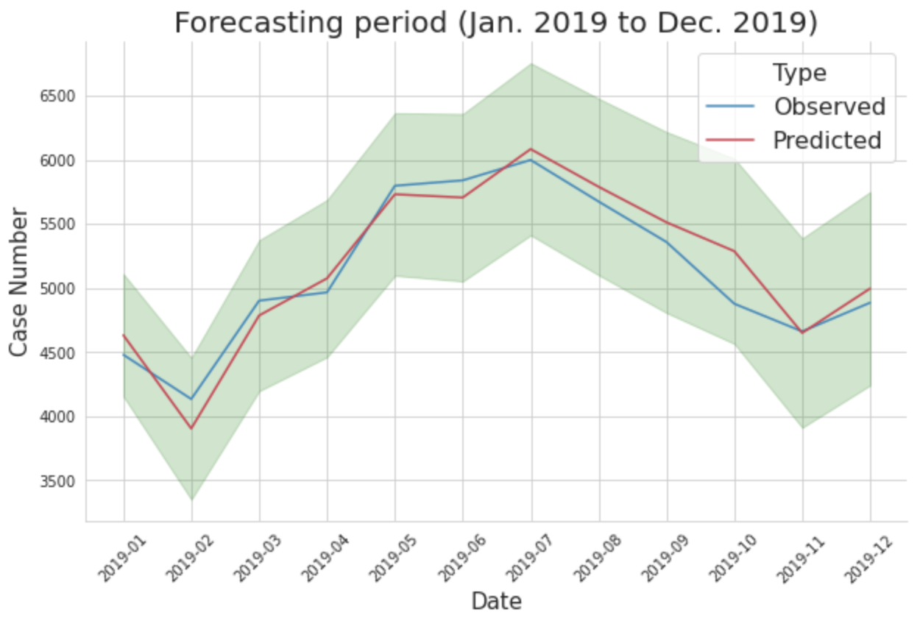
Chicago crime case number forecasting
Evaluation metrics:
MAPE (lower is better): 0.0285
Corr (closer to 1 is better): 0.9621

Slide 17
Project Summary
Setting up objectives
Extract spatial and temporal pattern from historical crime data and use the gained insights to help improve police patrol strategies.
Choosing the right tools
The crime dataset has millions of records, making Apache Spark an ideal analytical tool for downstream tasks.
Explorative data analysis
Perform data cleaning and find insights and patterns (e.g. seasonality, crime hotspots etc.) with visualizations.
Spatial clustering (unsupervised ML)
Time series forecasting (supervised ML)
Used K-means clustering algorithm to find ideal locations to build police station.
Used historical crime data and weather data to build an ARIMA model. Predicted future crime case number and evaluated model performance.

Slide 18

Thank you

